Slide 1


Slide 2

“I want green grass.”
Notes:
You’ve seen our application, so I don’t want to be repetitive. What I’d like to do today is tell you a story. A story about how our community has evolved over the last 3 plus years. Specifically, our approach to parks, recreation, and economic development.
Quote from Councilor Osgood during City Administrator candidate interviews
My response to Councilor Osgood: We can do anything you want, but not everything you want. We’ve got to make a plan and prioritize our scarce resources. .

Slide 3
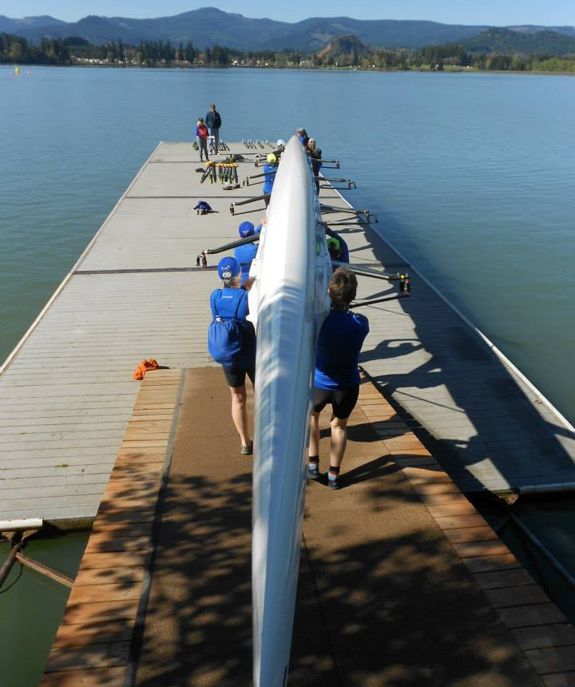
FY 2016/17 Strategic Plan
Vision
Mission
Goals
Objectives
Measurement Criteria
Notes:
First 3-4 months getting to know the community and cleaning up the finances. Then it was time to plan.

Slide 4
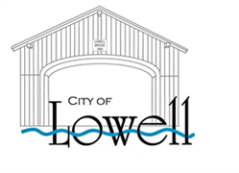
Years in the making…
  2016/17 Strategic Plan
  2018 Strategic Plan
  2019 Strategic Plan
  2019 Downtown Master Plan
  2019 Parks and Recreation Master Plan
Notes:
From first strategic plan to adopted budget for next year, our community has made substantive progress. Each plan has built on this progress.

Slide 5
Community Engagement
Steering Committees
Household Survey
Focus Groups
Public Events
Workshops
Public Hearings

Slide 6
Key Findings
Downtown
  A central park will be at the heart of downtown and provide a tree-lined, comfortable place for pedestrians.
  Incorporate an interconnected system of sidewalks and multi-modal pathways to better connect greenspaces and amenities such as Dexter Lake.
Parks
  Larger restroom facilities
  Additional green space/natural areas for passive recreation
  Facilities to accommodate parties and group gatherings
  Host additional events
  Develop new trail connections between parks and recreation amenities
  Integrate Rolling Rock Park into Downtown

Slide 7
The Project
  Through all of the outlined planning efforts, there was a clear consensus that Rolling Rock Park was the first priority.
  Rolling Rock Park is located in the heart of downtown, highly visible, and serves as venue for community events.
  Parks and Recreation Steering Committee voted unanimously to apply for an OPRD Local Government Grant.

Slide 8
The Project
  A Central Park with…
    Turf
    Irrigation
    Inclusive Playground
    Amphitheater seating
    Large shelter
    Restrooms
    Walking paths
    Interpretive exhibits

Slide 9
Notes:
We can do anything you want, but not everything you want.

Slide 10
Project Goals
  Develop the region’s only inclusive playground
  Create more open – FLAT – space for passive recreation and picnics
  Support and attract downtown events to serve residents and boost local tourism
  Relocate and improve logging exhibits to highlight the region’s rich timber nhistory
  Serve as “hub” for “spokes” to regional parks, trails, and other recreational assets, such as Lowell State Park, Orchard Park, Covered Bridge Interpretive Center and future Eugene to Pacific Crest Trail
Notes:
As you will see in the next few slides, our community has many large events that take place throughout the year. We just haven’t had the supporting infrastructure for the community to reap much benefit. This project was developed to be the economic catalyst for Lowell….which for us is serving as a recreation hub for sports such as boating, kayaking, hiking, and cycling.

Slide 11
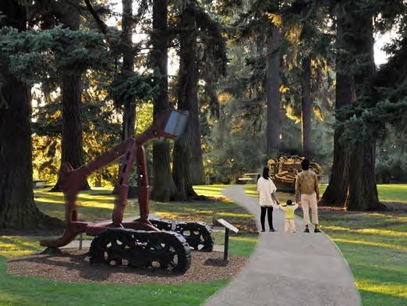
Interpretive Logging Exhibits

Slide 12
Project Budget Summary
Property Acquisition $390,000
Improvements $788,795
  Turf
  Irrigation
  ADA Playground
  Amphitheater seating
  Large shelter
  Restrooms
  Walking paths
  Interpretive exhibits
Total $1,178,795
City $428,795 (36%)
  OPRD $750,000 (64%)

Slide 13
Making Progress…
  Conceptual design trail system
  Relocation of Dexter Lake Farmers Market
  Development of Lowell Beautification Day
  First Paddle Sports Demo Day
  Growth of Blackberry Jam Festival
  Growth of Holiday Bridge Lighting
  Growth of Covered Bridge Regattas
  Growth of CDBA Racing Circuit
  Acquisition of Rolling Rock Park Property
Notes:
One of my pet peeves in past grant writing was being forced to apply for grants before the City was ready. Before the City could save the resources for match funding and actually demonstrate the ability to make progress with existing resources.

Slide 14
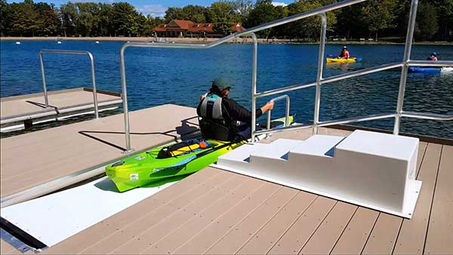
Conceptual Trail System
  Walking trails
  Bike trails, including Covered Bridge Tour
  Lake Access Points

Slide 16
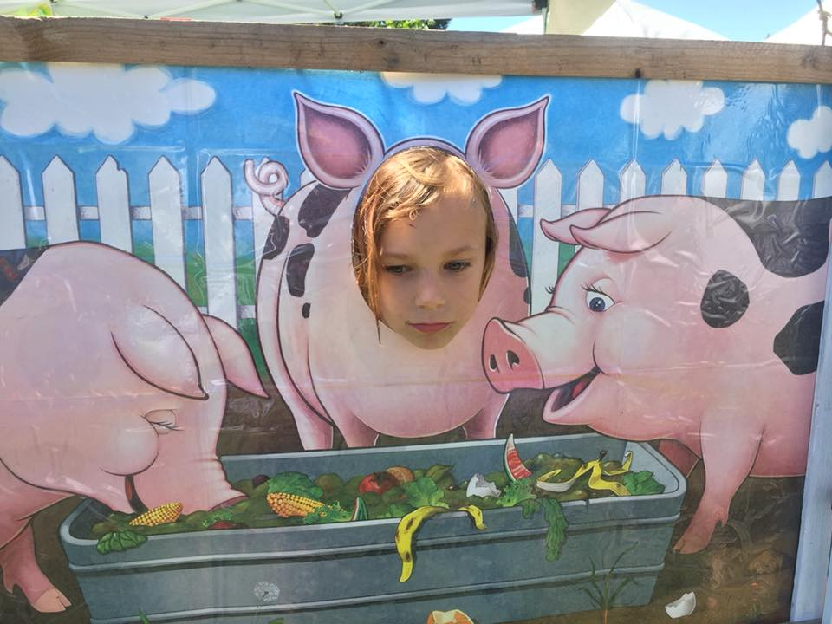
Dexter Lake Farmers Market

Slide 17
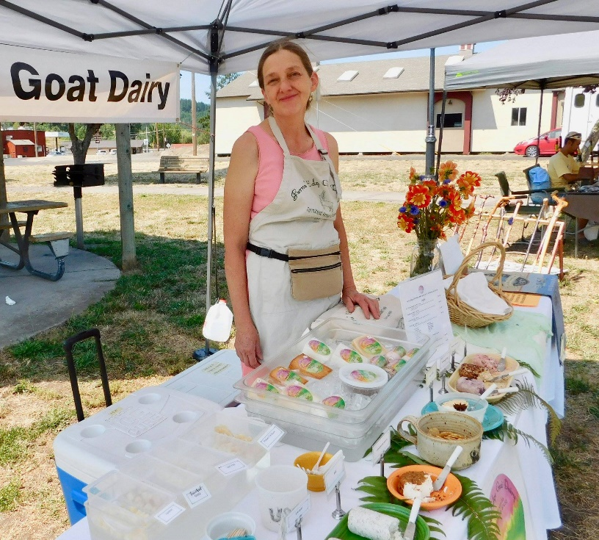
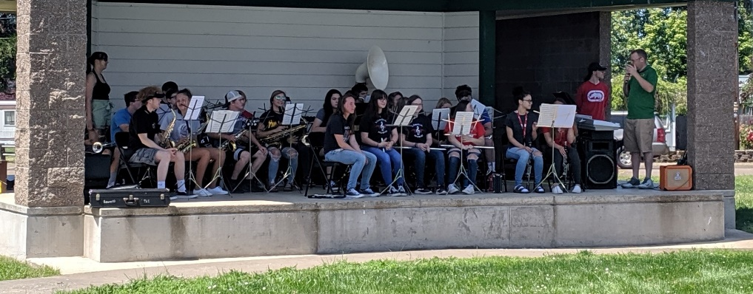
Dexter Lake Farmers Market
Relocated to Rolling Rock Park in 2017
Vendors from Lowell, Fall Creek, Dexter, Pleasant Hill
Every Sunday from June through September

Slide 18
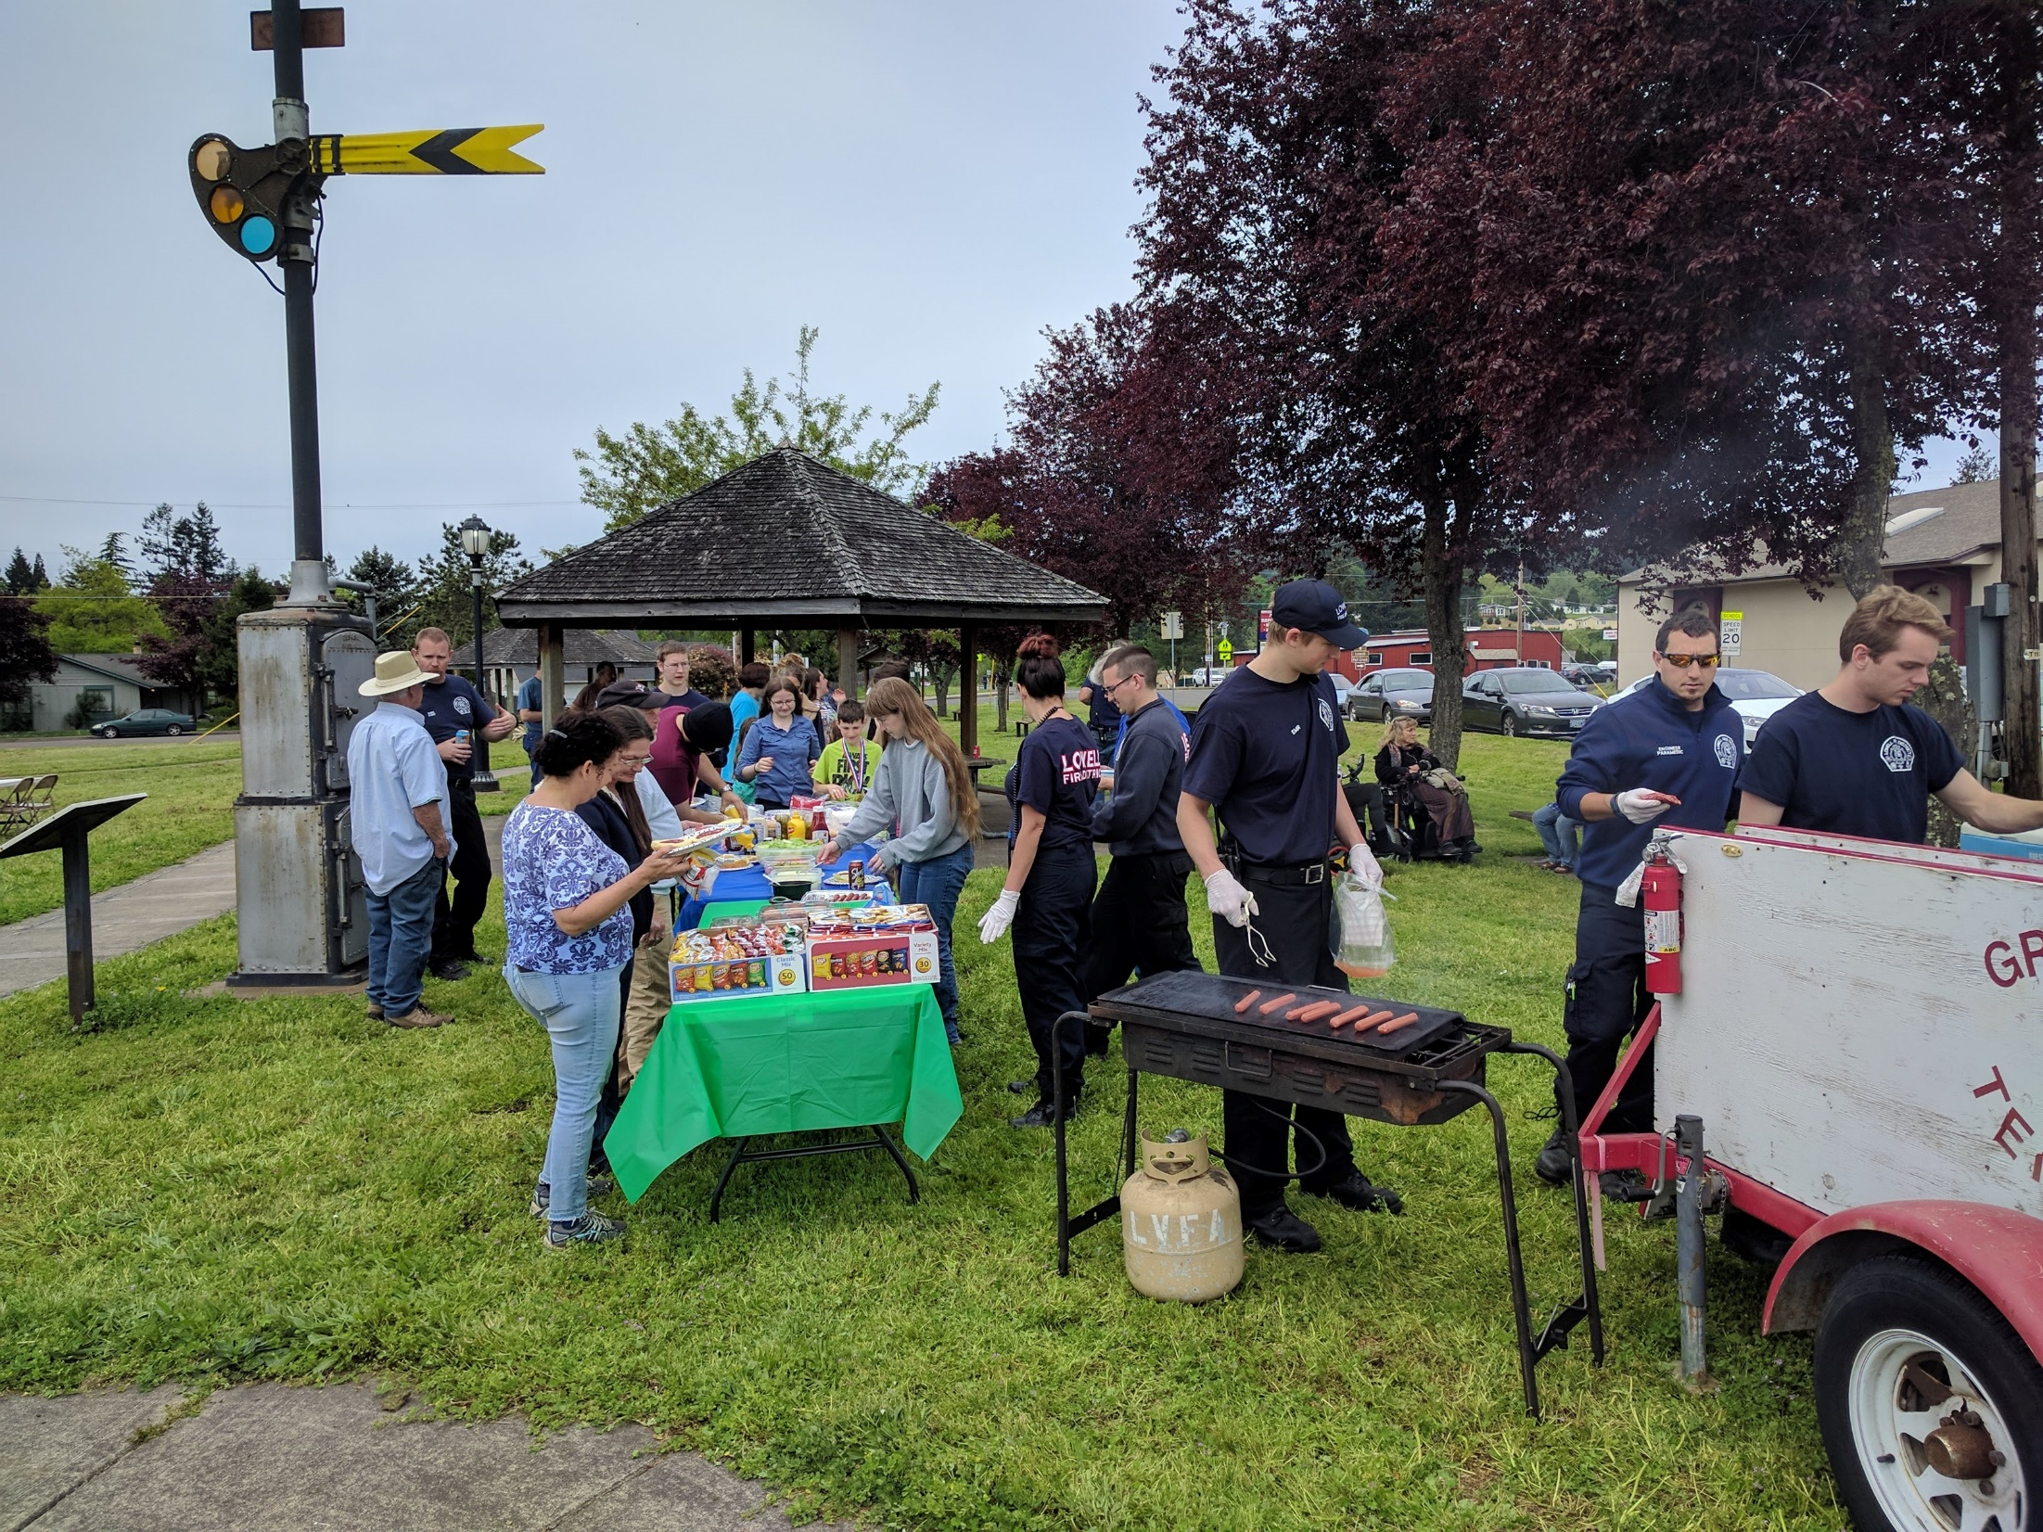
Lowell Beautification Day

Slide 19
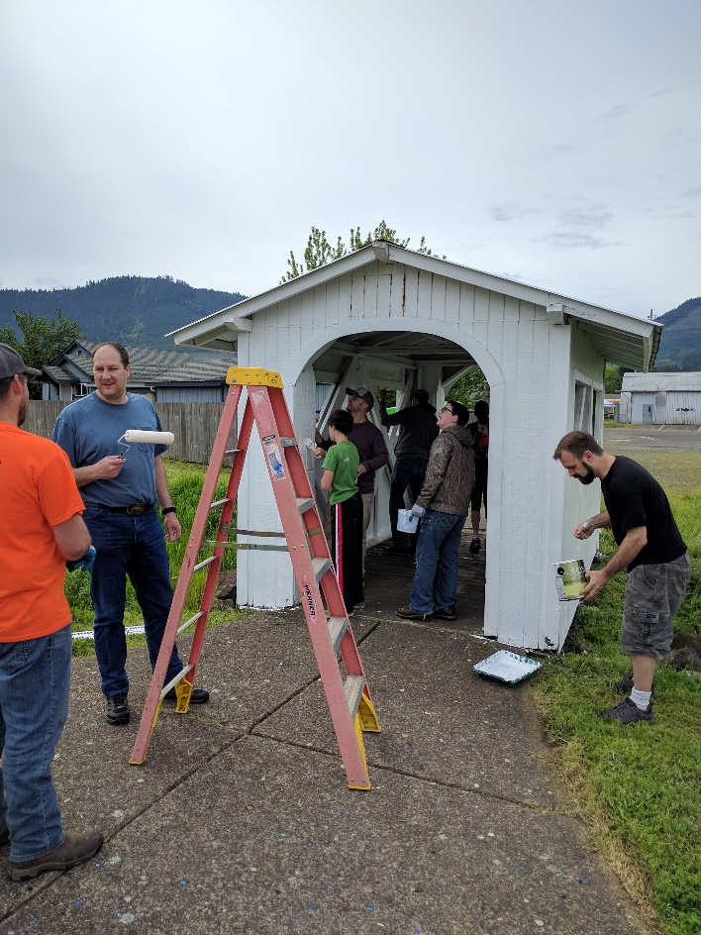
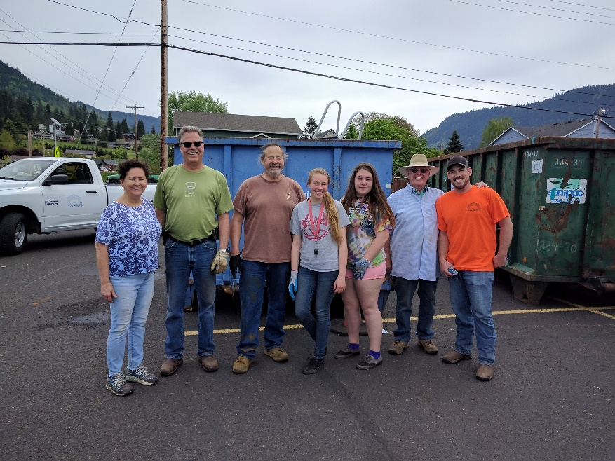
Lowell Beautification Day
Trash and recycling roll off containers for spring cleaning
Volunteer parks maintenance projects
Appreciation BBQ

Slide 20
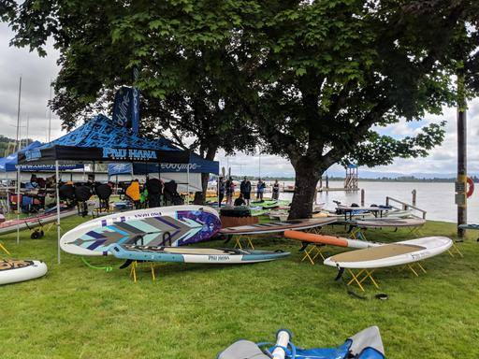
Paddle Sports Demo Day

Slide 21
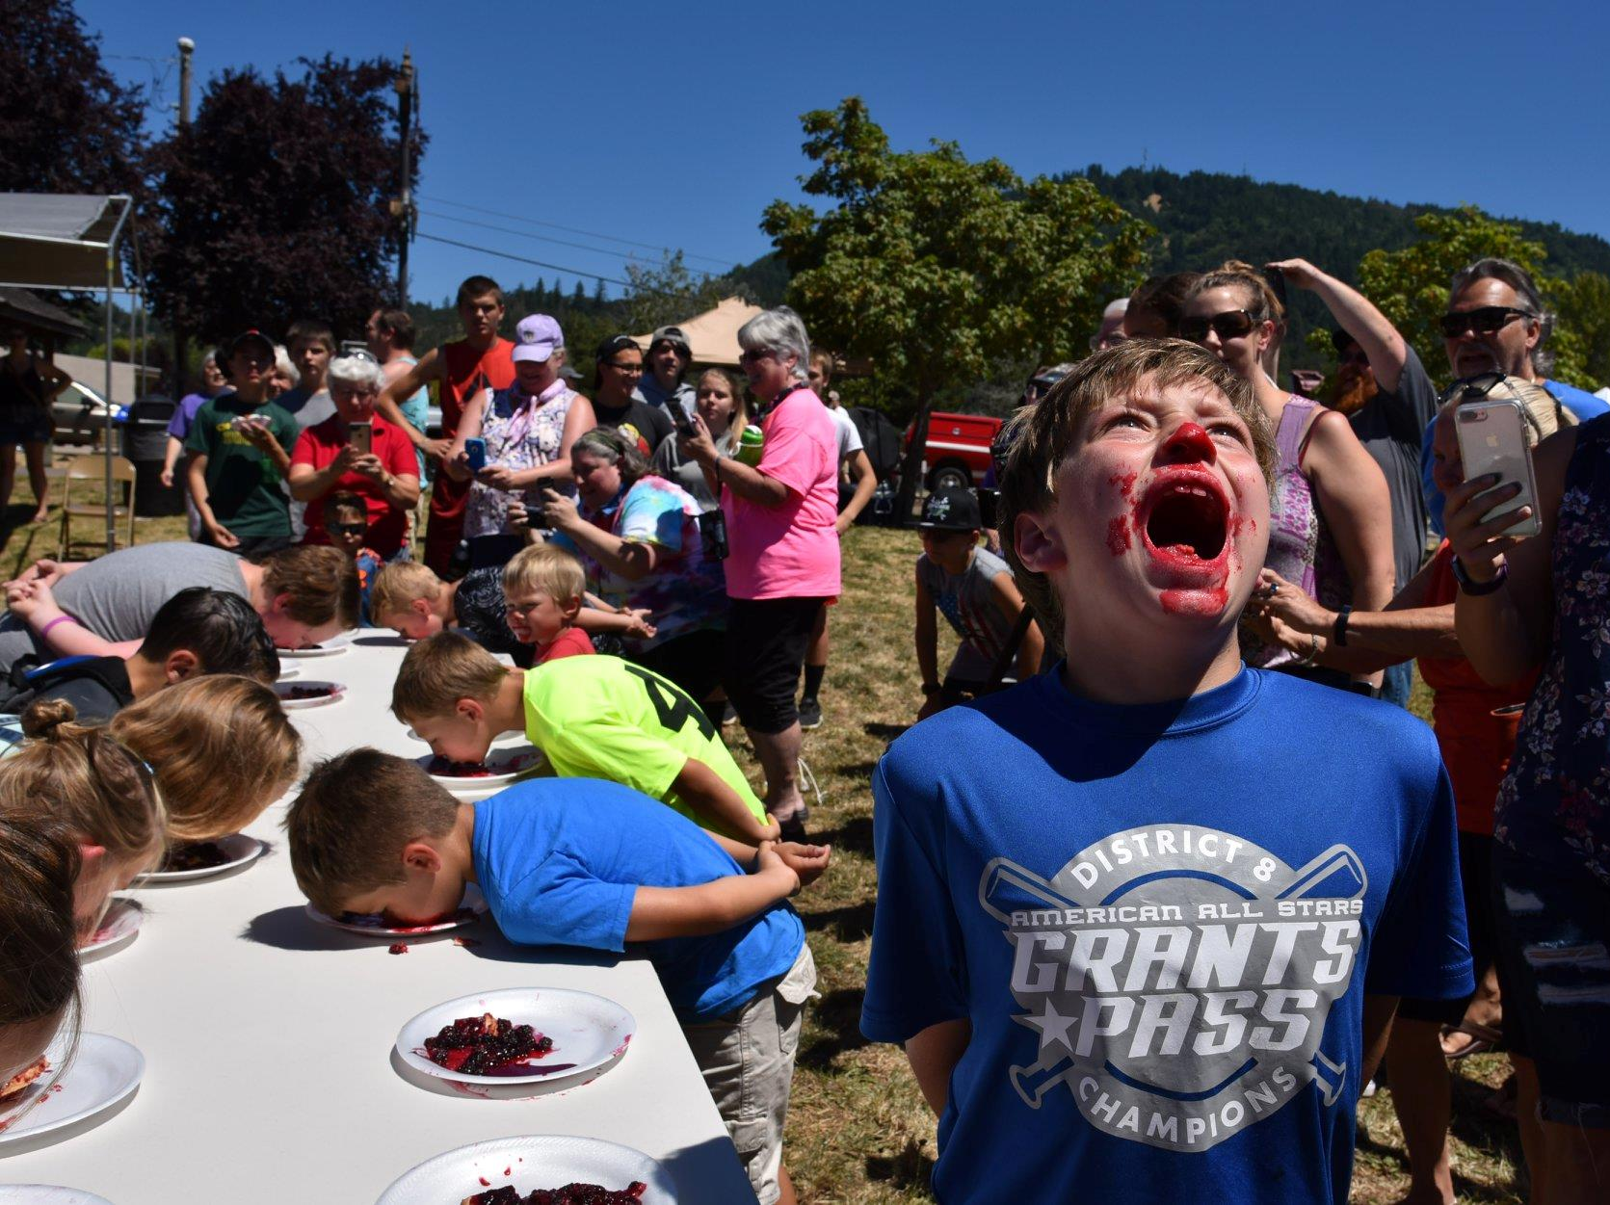
Blackberry Jam Festival

Slide 22
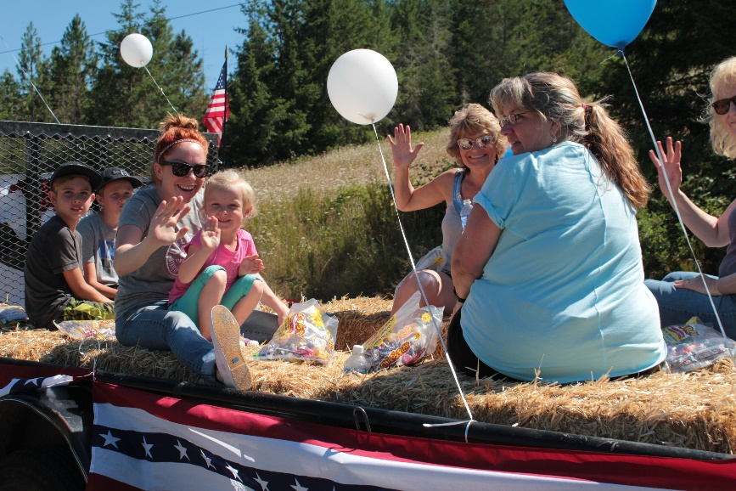
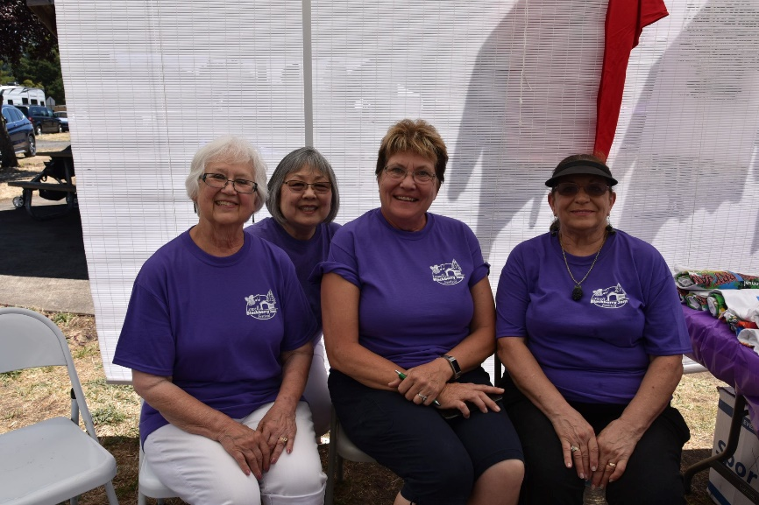
Blackberry Jam Festival
Vendors and patrons from Lane County and beyond
Activities:
  Live Music
  Pie Eating Contest
  Pie Baking Contest
  Fishing Derby
  Car Show
  5K Run
  Kids Activities
  Local Crafters
  Local Food Trucks
  Commercial Booths

Slide 23
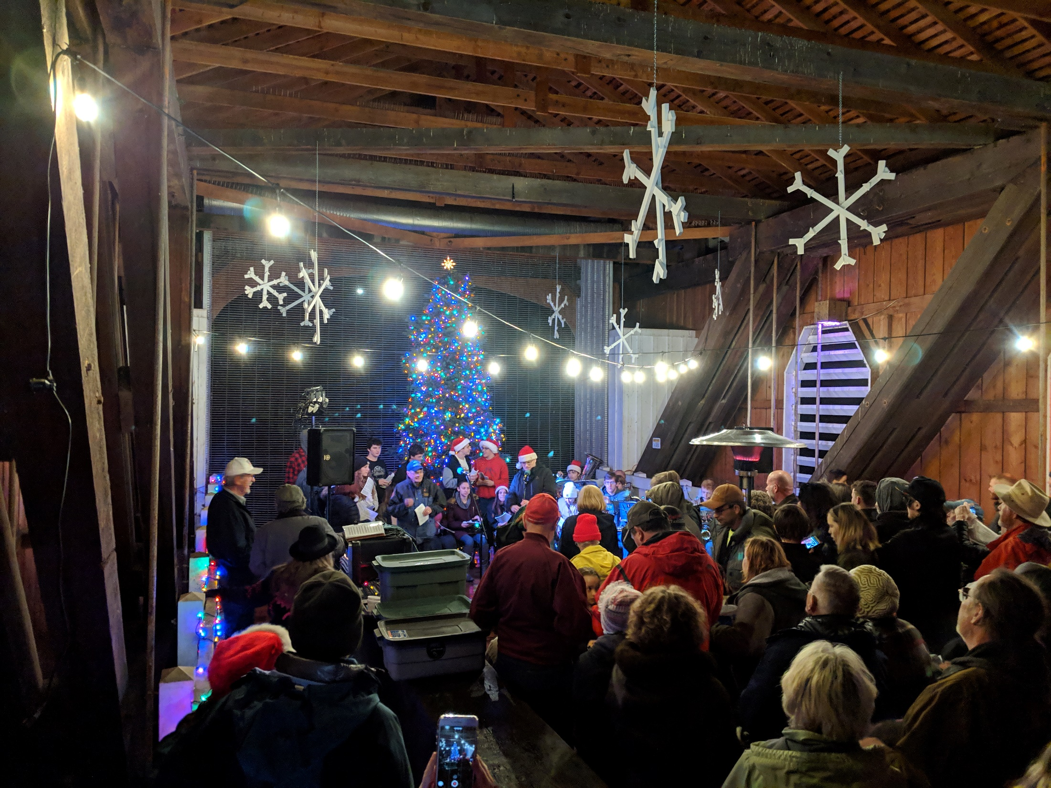
Covered Bridge Lighting

Slide 24
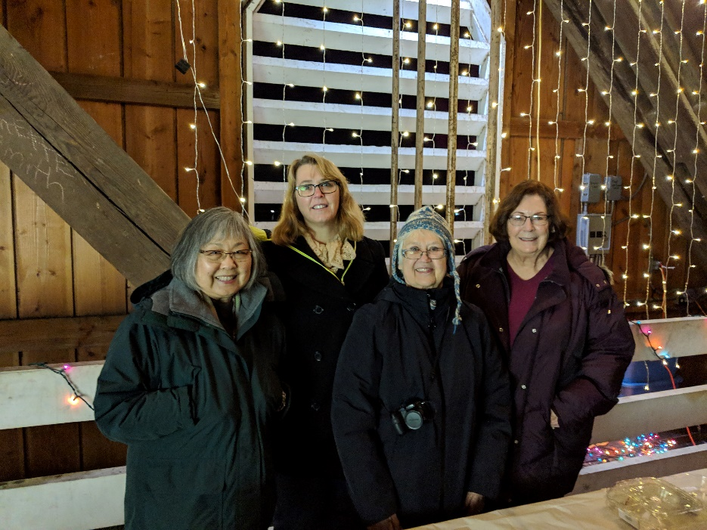
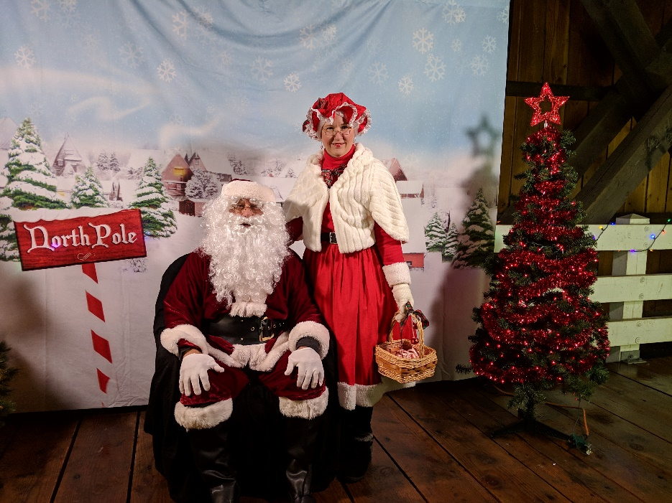
Covered Bridge Lighting
Covered Bridge decorated by the Parks & Recreation Committee and volunteers
400-500 attendees
Activities:
  Refreshments
  Christmas Carolers
  HS Band and Choir
  Mr. and Mrs. Claus
  Tree Lighting Ceremony
  Boat Parade
Notes:
Lowell HS provides bus transportation to/from Covered Bridge
Lowell Fire District provides traffic control and parking
Lowell Grange provides refreshments

Slide 25
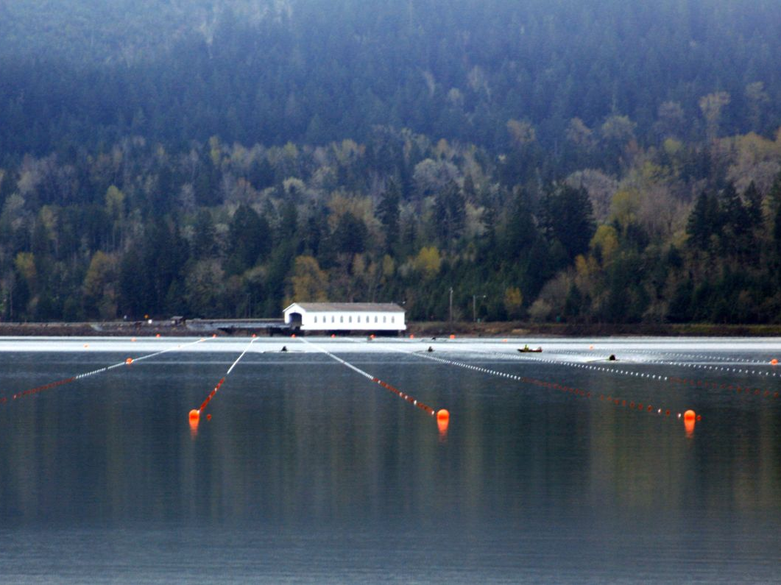
Covered Bridge Regatta

Slide 26
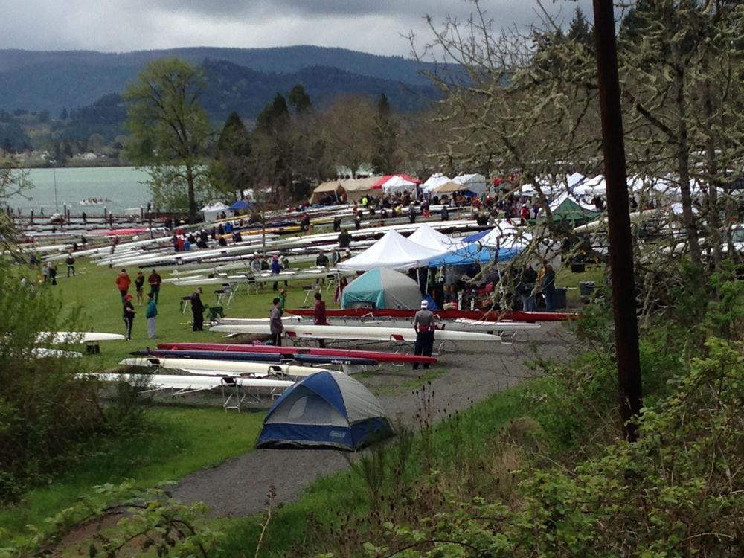
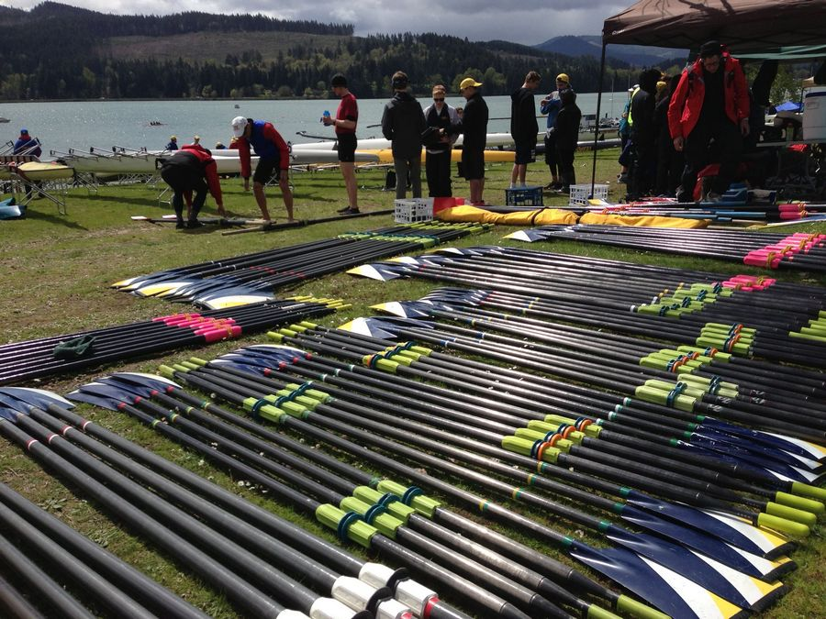
Covered Bridge Regatta
Over 1,500 participants
Venues include Lowell State Park and Covered Bridge Interpretive Center
Notes:
Venues – Opposite ends of town. Rolling Rock Park serves as the transportation hub to shuttle spectators between venues.

Slide 27
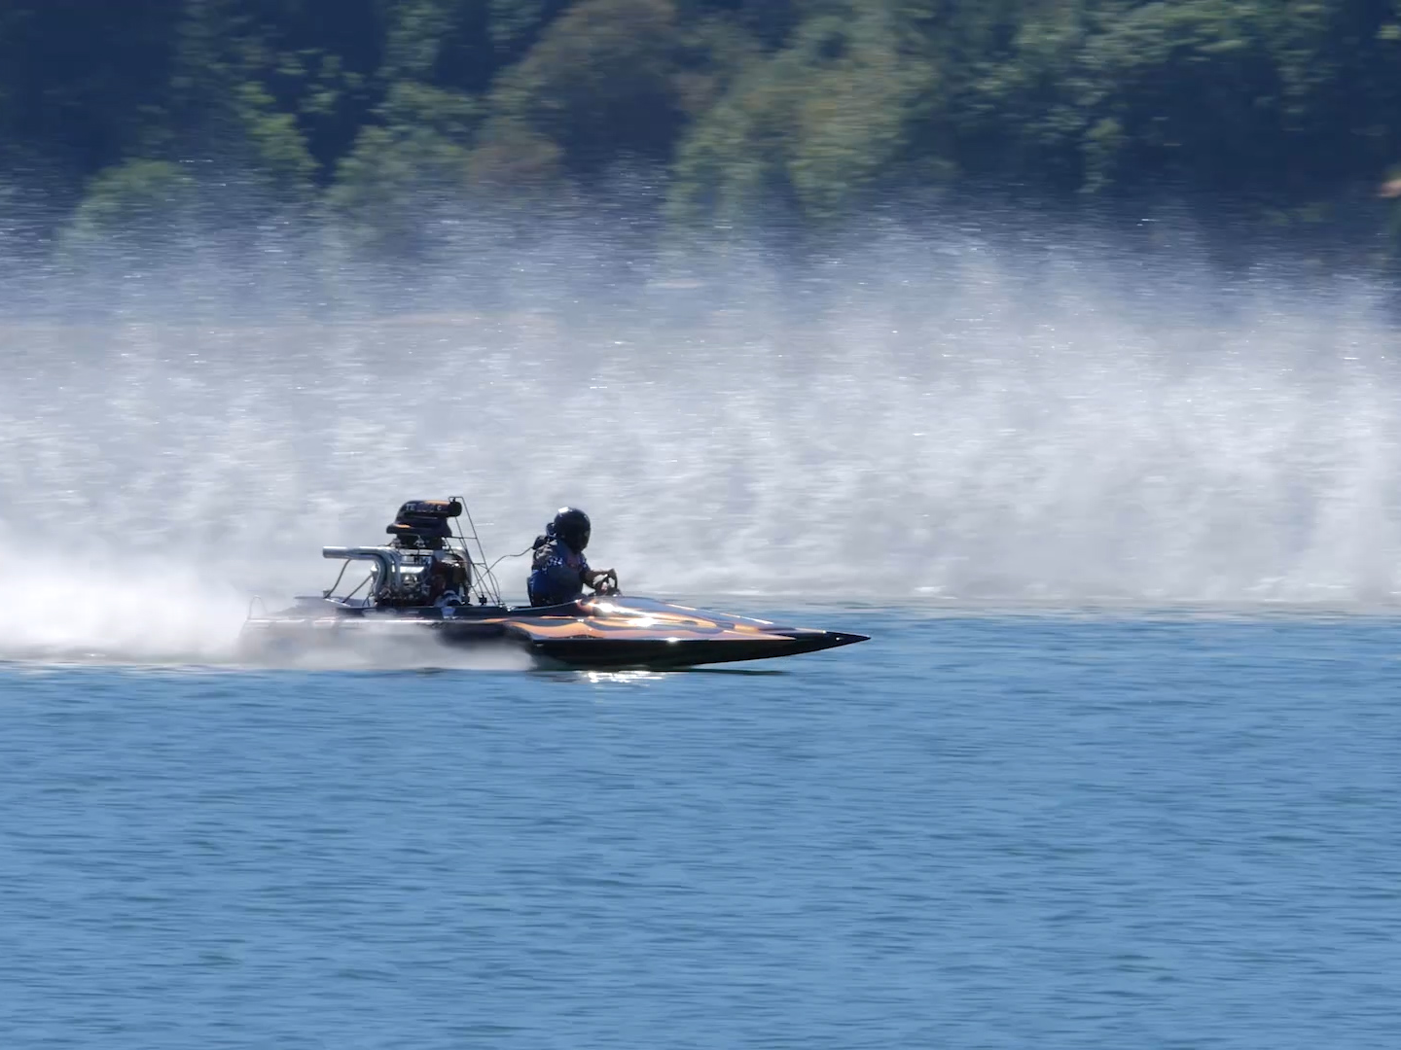
CDBA Racing Circuit

Slide 28
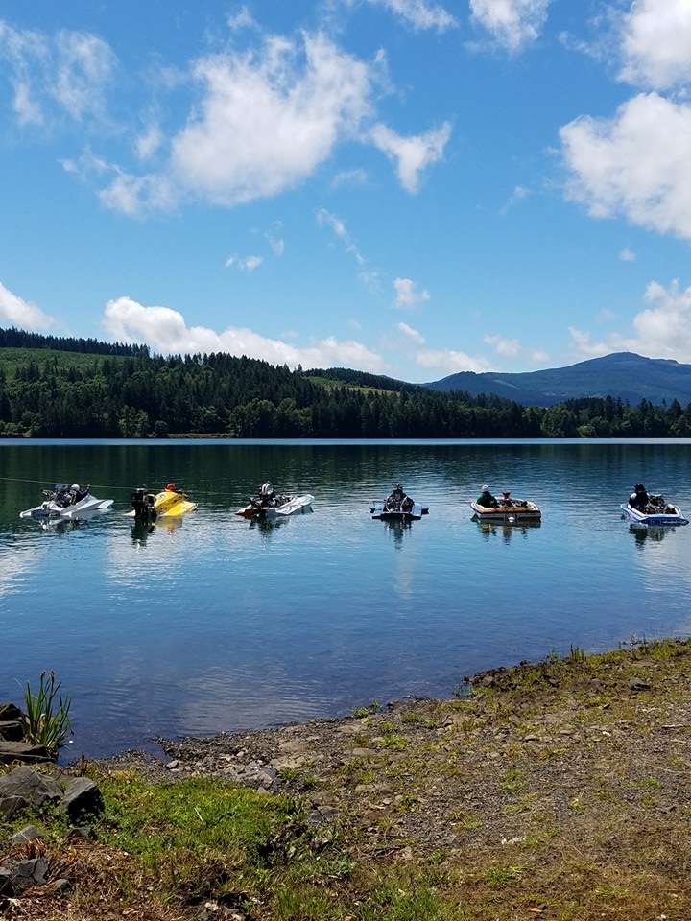
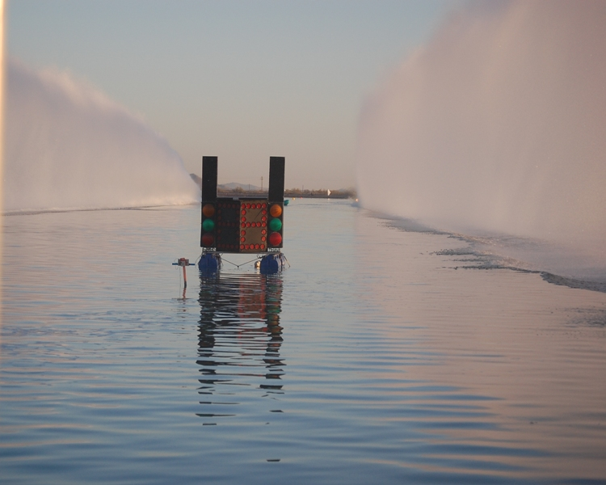
CDBA Racing Circuit
Dexter Lake is home to CDBA
Vendors and patrons from Pacific Northwest
3 Summer Boat Races sponsored by Bi-Mart and Can Am

Slide 29
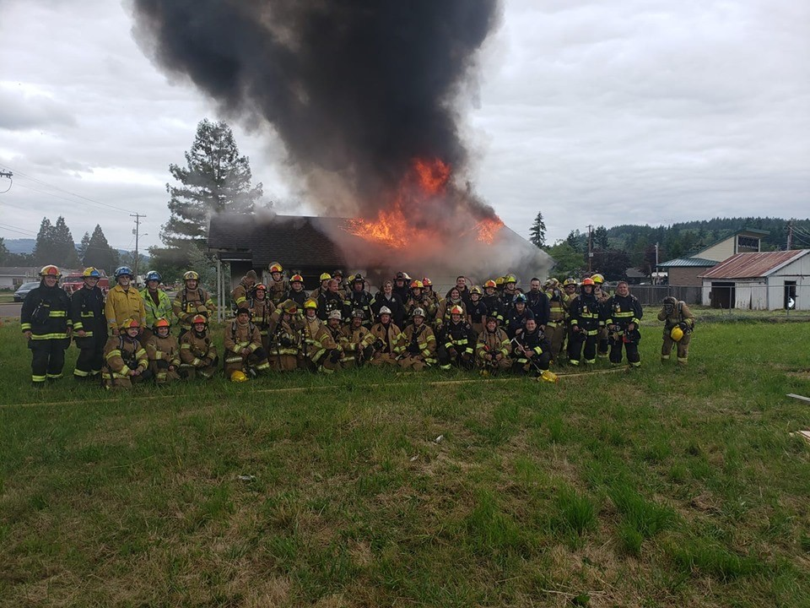
Rolling Rock Property Acquisition

Slide 30
Maintaining Momentum
Relocation of City Hall & Library
New High School Gymnasium
Elementary & JR/SR High renovations
New Business Opening
And COMING SOON…

Slide 31
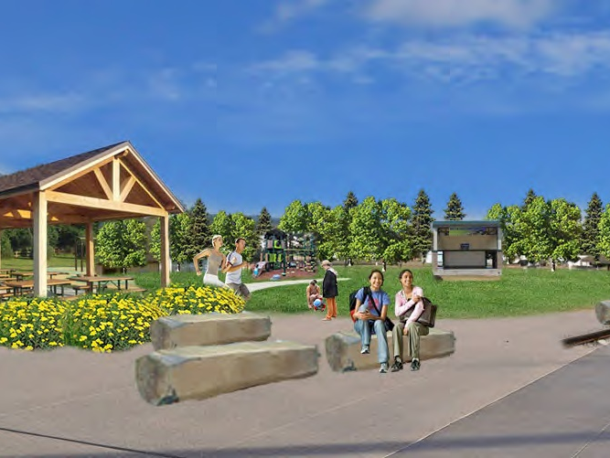
A Central Park and Hub for Recreation and Events

Slide 32
